Slide 1
ADVANCED
RELATIONAL ALGEBRA
Lecture 12

Slide 2

OUTER JOIN OPERATION
In NATURAL JOIN tuples without a matching (or related) tuple are eliminated from the join result. Tuples with null in the join attributes are also eliminated. This amounts to loss of information.
A set of operations, called Outer Joins, can be used when we want to keep all the tuples in R, or all those in S, or all those in both relations in the result of the join, irrespective of whether or not they have matching tuples in the other relation.

Slide 3
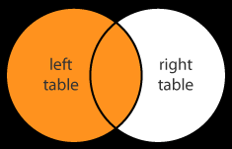
LEFT OUTER JOIN ( )
The Left Outer Join operation keeps every tuple in the first or left relation R in R S.
If no matching tuple is found in S, then the attributes of S in the join result are filled or “padded” with null values.
If R has ‘n’ tuples and S has ‘m’, then
Cardinality: min = n
        max = n * m

Slide 4
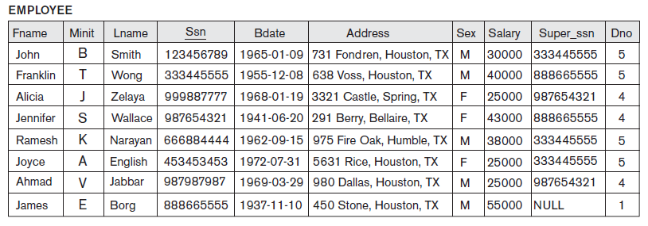
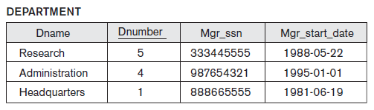
LEFT OUTER JOIN EXAMPLE

Slide 5
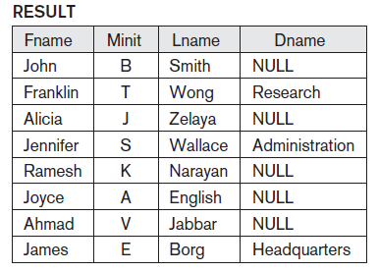
LEFT OUTER JOIN EXAMPLE
A list of all employee names as well as the name of the departments they manage if they happen to manage a department; if they do not manage one, indicate a NULL value.
Query:
TEMP ← (EMPLOYEE _{Ssn=Mgr_ssn}DEPARTMENT)
RESULT ← π_{Fname, Minit, Lname, Dname}(TEMP)
Output:

Slide 6
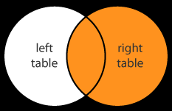
RIGHT OUTER JOIN ( )
Right Outer Join, keeps every tuple in the second or right relation S in the result of R S.
If no matching tuple is found in R, then the attributes of R in the join result are filled or “padded” with null values.
If R has ‘n’ tuples and S has ‘m’, then
Cardinality: min = m
        max = n * m

Slide 7
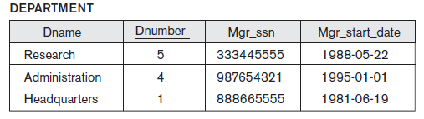
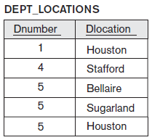
RIGHT OUTER JOIN EXAMPLE
Query:
TEMP ← (DEPARTMENT DEPT_LOCATIONS)
RESULT ← π_{Dname, Dnumber, Dlocation} (TEMP)
Output:
Dname | Dnumber | Dlocation
Headquarters | 1 | Houston
Administration | 4 | Stafford
Research | 5 | Bellaire
Research | 5 | Sugarland
Research | 5 | Houston

Slide 8
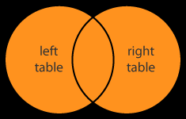
FULL OUTER JOIN ( )
  Full Outer Join, denoted by keeps all tuples in both the left and the right relations when no matching tuples are found, padding them with null values as needed.
  R S = (R S) U (R S)
  If R has ‘n’ tuples and S has ‘m’, then
Cardinality: min = max (n, m)
        max = n * m

Slide 9
FULL OUTER JOIN EXAMPLE

Slide 10
FULL OUTER JOIN EXAMPLE
Query:
TEMP ← (EMPLOYEE _{Ssn=Mgr_ssn} DEPARTMENT)
RESULT ← π _{Fname, Minit, Lname, Dname}(TEMP)
Output:
Same as output of Left Outer Join as all tuples of DEPARTMENT had corresponding matching tuples in EMPLOYEE

Slide 11

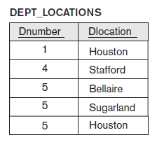
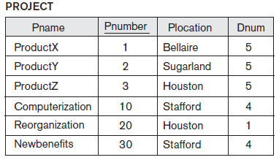
INTERSECTION OPERATION
INTERSECTION OPERATION
The result of this operation, denoted by R ∩ S, is a relation that includes all tuples that are in both R and S. The two operands must be "type compatible"
Example:

Slide 12
INTERSECTION OPERATION EXAMPLE
Query:
TEMP ← π_{Dnum, Plocation} (PROJECT)
RESULT ← DEPT_LOCATIONS ∩ TEMP
Output:
  TEMP RESULT
Dnum | Plocation
5 | Bellaire
5 | Sugarland
5 | Houston
4 | Stafford
1 | Houston
4 | Stafford
Dnumber | Dlocation
1 | Houston
4 | Stafford
5 | Bellaire
5 | Sugarland
5 | Houston

Slide 13
PROPERTIES OF RELATIONAL ALGEBRA OPERATIONS
Both union and intersection are commutative operations; that is
R ∪ S = S ∪ R, and R ∩ S = S ∩ R
Both union and intersection can be treated as n-ary operations applicable to any number of relations as both are associative operations; that is
R ∪ (S ∪ T) = (R ∪ S) ∪ T, and (R ∩ S) ∩ T = R ∩ (S ∩ T)
The minus operation is not commutative; that is, in general
R - S ≠ S – R

Slide 14
COMPLETE SET OF RELATIONAL OPERATIONS
The set of operations including Select σ, Project π , Union ∪, Set Difference - and Cartesian/Cross Product X is called a complete set because any other relational algebra expression can be expressed by a combination of these five operations.
For example:
R ∩ S = (R ∪ S ) – ((R − S) ∪ (S − R))
R _{<join condition>} S = σ _{<join condition>} (R X S)

Slide 15
DIVISION OPERATION
The division operation is applied to two relations R(Z) ÷ S(X), where X subset Z.
Let Y = Z - X (and hence Z = X ∪ Y); that is, let Y be the set of attributes of R that are not attributes of S.
The result of DIVISION is a relation T(Y) that includes a tuple t if tuples t_{R} appear in R with t_{R} [Y] = t, and with
  t_{R} [X] = t_{s} for every tuple t_{s} in S
For a tuple t to appear in the result T of the DIVISION, the values in t must appear in R in combination with every tuple in S.

Slide 16
DIVISION OPERATION EXAMPLE
PROJECT DEPARTMENT
Pname | Pnumber | Plocation | Dnumber
ProductX | 1 | Bellaire | 5
ProductY | 2 | Stafford | 5
ProductZ | 3 | Houston | 5
Newbenefits | 10 | Stafford | 4
ProductZ | 3 | Houston | 1
ProductZ | 3 | Sugarland | 4
Dnumber
1
4
5
Retrieve the Project Number that are being executed in all the departments.
Query:
(π _{Pnumber, Dnumber} (PROJECT)) ÷ π _{Dnumber} (DEPARTMENT)
Output:
Pnumber
3

Slide 17
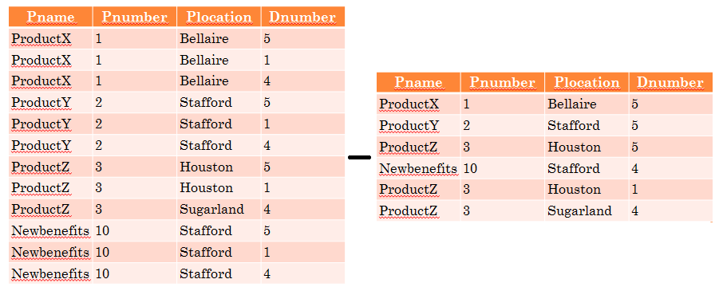
DIVISION OPERATION AS A DERIVED OPERATION
Sequence of π, ×, – operations = ÷ operation
Step 1: Project numbers not executed in all departments
π _{Pnumber} ((π _{Pname, Pnumber, Plocation} (PROJECT) X π _{Dnumber} (DEPARTMENT)) – PROJECT)

Slide 18
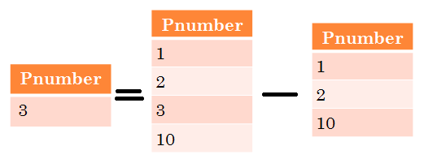
Pnumber
1
2
10
Output of Step 1:
Step 2: Project Number that are being executed in all the departments i.e. Project numbers that are being executed in some departments – Project numbers not executed in all departments
π _{Pnumber} (PROJECT) - Step 1
i.e.
π _{Pnumber} (PROJECT) - π _{Pnumber} ((π _{Pname, Pnumber, Plocation} (PROJECT) X
π _{Dnumber} (DEPARTMENT)) – PROJECT)
Output of Step 2:

Slide 19
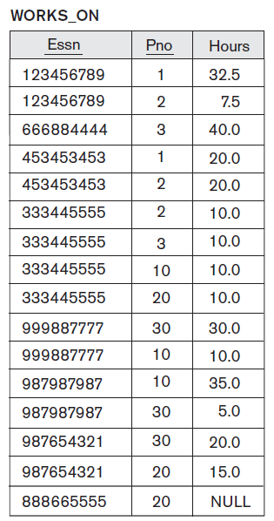
DIVISION OPERATION EXAMPLE
Chapter 6-<number>

Slide 20
DIVISION OPERATION EXAMPLE
Retrieve the names of employees who work on all the projects that ‘John Smith’ works on.
  Query:
  JS_PROJECTS ← π_{Pno} ((σ Fname = ‘John’ AND Lname = ‘Smith’ (EMPLOYEE)) ⋈ _{Ssn = Essn} WORKS_ON))
  TEMP ← (π _{Essn,} _{Pno} (WORKS_ON)) ÷ JS_PROJECTS
  RESULT ← π _{Fname,} _{Lname} ( TEMP ⋈ _{Essn = Ssn} EMPLOYEE )
  Output:
  JS_PROJECTS TEMP RESULT
Pno
1
2
Essn
123456789
453453453
Fname | Lname
John | Smith
Joyce | English

Slide 21
RELATIONAL ALGEBRA OPERATORS
Operation | Purpose | Notation
LEFT OUTER JOIN | Produces every tuple in the first or left relation R1 in R1 R2. | R1 R2
RIGHT OUTER JOIN | Produces every tuple in the second or right relation R1 in R1 R2. | R1 R2
FULL OUTER JOIN | Produces all tuples in both the left and right relations when no matching tuples are found, padding them with null values as needed. | R1 R2
INTERSECTION | Produces a relation that includes all the tuples in both R1 and R2; R1 and R2 must be union compatible. | R1 ∩ R2
DIVISION | Produces a relation R(X) that includes all tuples t[X] in R1(Z) that appear in R1 in combination with every tuple from R2(Y), where Z = X ∪ Y. | R1(Z) ÷ R2(Y)

Slide 22
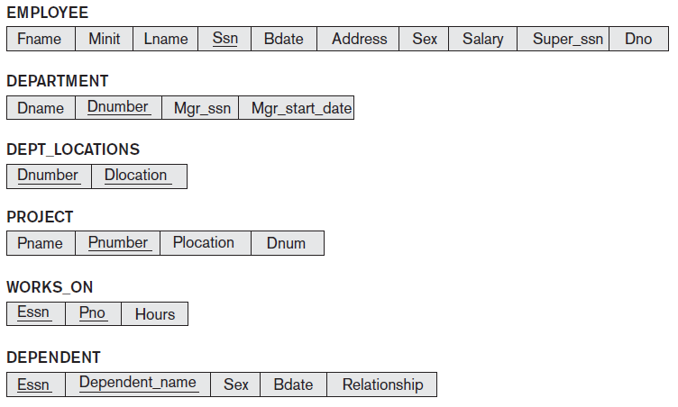
COMPANY DATABASE

Slide 23
PRACTICE QUERIES
Q1: Retrieve the name and address of all employees who work for the ‘Research’ department.
Q2: For every project located in ‘Stafford’, list the project number, the controlling department number and the department manager’s last name, address, and birth date.
Q3: Find the names of employees who work on all the projects controlled by department number 5.

Slide 24
PRACTICE QUERIES SOLUTION
Q1:
π _{Fname, Lname, Address} (σ _{Dname=‘Research’}(DEPARTMENT⋈ _{Dnumber=Dno} (EMPLOYEE))
Q2:
STAFFORD_PROJS ← σ _{Plocation=‘Stafford’}(PROJECT)
CONTR_DEPTS ← (STAFFORD_PROJS ⋈ _{Dnum=Dnumber} DEPARTMENT)
PROJ_DEPT_MGRS ← (CONTR_DEPTS ⋈ _{Mgr_ssn=Ssn} EMPLOYEE)
RESULT ← π Pnumber, Dnum, Lname, Address, Bdate (PROJ_DEPT_MGRS)
Q3:
DEPT5_PROJS ← ρ_{(Pno)} (π _{Pnumber} (σ _{Dnum=5} (PROJECT)))
EMP_PROJ ← ρ _{(Ssn, Pno)} (π _{Essn, Pno} (WORKS_ON))
RESULT_EMP_SSNS ← EMP_PROJ ÷ DEPT5_PROJS
RESULT ← π _{Lname, Fname} (RESULT_EMP_SSNS * EMPLOYEE)

Slide 25
PRACTICE QUERIES
Q4: Make a list of project numbers for projects that involve an employee whose last name is ‘Smith’, either as a worker or as a manager of the department that controls the project.
Q5: Retrieve the names of employees who have no dependents.
Q6: List the names of managers who have at least one dependent.

Slide 26
PRACTICE QUERIES SOLUTION
Q4:
π _{Pno} (WORKS_ON ⋈ _{Essn=Ssn} (π _{Ssn} (σ _{Lname=‘Smith’} (EMPLOYEE))) ∪ π _{Pno} ((π _{Dnumber} (σ _{Lname=‘Smith’} (π _{Lname, Dnumber} (EMPLOYEE)))
⋈ _{Ssn=Mgr_ssn} DEPARTMENT)) ⋈ _{Dnumber=Dnum} PROJECT)
=====================
SMITHS (Essn) ← π _{Ssn} (σ _{Lname=‘Smith’} (EMPLOYEE))
SMITH_WORKER_PROJS ← π_{Pno}(WORKS_ON * SMITHS)
MGRS ← π _{Lname, Dnumber} (EMPLOYEE ⋈ _{Ssn=Mgr_ssn} DEPARTMENT)
SMITH_MANAGED_DEPTS (Dnum) ← π _{Dnumber} (σ _{Lname=‘Smith’} (MGRS))
SMITH_MGR_PROJS (Pno) ← π _{Pnumber} (SMITH_MANAGED_DEPTS * PROJECT)
RESULT ← (SMITH_WORKER_PROJS ∪ SMITH_MGR_PROJS)

Slide 27
PRACTICE QUERIES SOLUTION
Q5:
ALL_EMPS ← π _{Ssn} (EMPLOYEE)
EMPS_WITH_DEPS (Ssn) ← π _{Essn} (DEPENDENT)
EMPS_WITHOUT_DEPS ← (ALL_EMPS – EMPS_WITH_DEPS)
RESULT ← π _{Lname, Fname} (EMPS_WITHOUT_DEPS * EMPLOYEE)
==================
Π _{Lname, Fname} ((π _{Ssn} (EMPLOYEE) – ρ _{Ssn}(π _{Essn} (DEPENDENT))) * EMPLOYEE)

Slide 28
PRACTICE QUERIES SOLUTION
Q6:
MGRS (Ssn) ← π _{Mgr_ssn} (DEPARTMENT)
EMPS_WITH_DEPS (Ssn) ← π _{Essn} (DEPENDENT)
MGRS_WITH_DEPS ← (MGRS ∩ EMPS_WITH_DEPS)
RESULT ← π _{Lname, Fname} (MGRS_WITH_DEPS * EMPLOYEE)

Slide 29
THANKS!!

